Slide 1

INDIAN INSTITUTE OF INFORMATION TECHNOLOGY , PUNE
INTERNSHIP PROJECT - I
DDOS ATTACK : DETECTION & MITIGATION
- using machine learning algorithms
MADE BY : PRATHAM DHADHIYA , 112115114
MENTORED BY : Dr.Anupama Arun

Slide 2



MADE BY –
PRATHAM DHADHIYA , 112115114
MENTORED BY –
Dr. ANUPAMA ARUN

Slide 3






TABLE OF CONTENTS
INTRODUCTION
MOTIVATION
LITERATURE REVIEW
RESEARCH GAP
PROBLEM STATEMENT
PROPOSED METHODOLOGY
RESULTS
CONCLUSION
REFERENCES
INTRODUCTION
MOTIVATION
LITERATURE SURVEY
RESEARCH GAP
PROPOSED METHOD & CO
NCLUSION

Slide 4

INTRODUCTION
DDoS Attack Definition: A Distributed Denial of Service (DDoS) attack [1] overwhelms a server or network with excessive traffic, making it unavailable to legitimate users.
Attack Mechanism: Multiple compromised systems (often botnets) flood the target with traffic, exhausting its resources (bandwidth, processing power, memory).
Impact: Disrupts services, causes downtime, and affects the availability of online platforms.
Growing Threat: The rise of IoT devices and botnets has increased the frequency and scale of DDoS attacks [4].
Importance of Mitigation: Critical for ensuring service uptime, protecting data, and preventing business disruptions [6].
R

Slide 5
MOTIVATION
Increasing Frequency: DDoS attacks are becoming more common due to the growing number of internet-connected devices and the ease of launching attacks with botnets [3].
Economic Impact: DDoS attacks result in financial losses due to service downtime, lost revenue, and recovery costs [8].
Reputation Damage: Prolonged outages can damage the reputation of businesses, leading to a loss of customer trust[8].
Complexity of Modern Attacks: DDoS attacks are evolving in scale and sophistication, making traditional defense mechanisms less effective [2].
Need for Better Defense: There is an urgent need for advanced, scalable, and cost-effective mitigation techniques to protect against the growing DDoS threat.
Importance of Continuity: Ensuring the availability of critical services during an attack is vital for businesses and organizations[5].
R

Slide 6
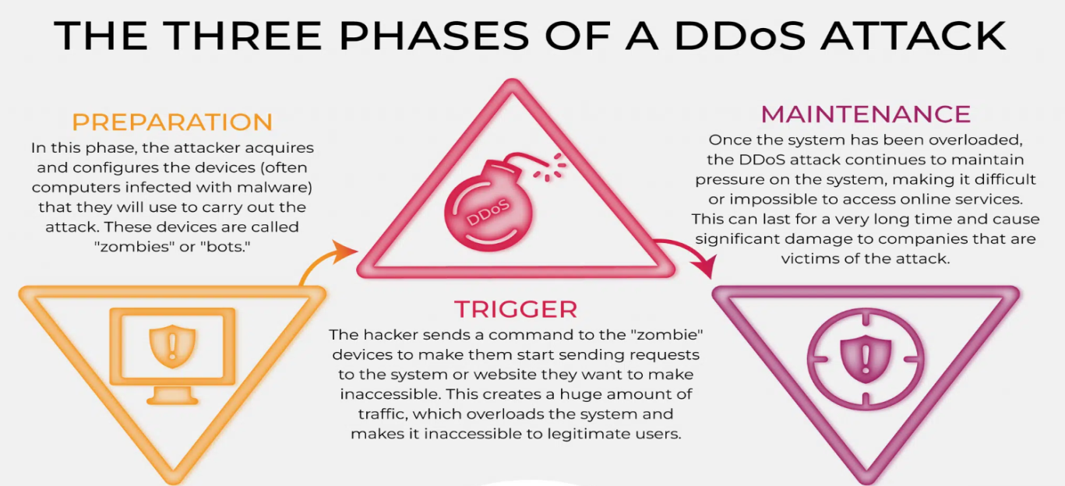
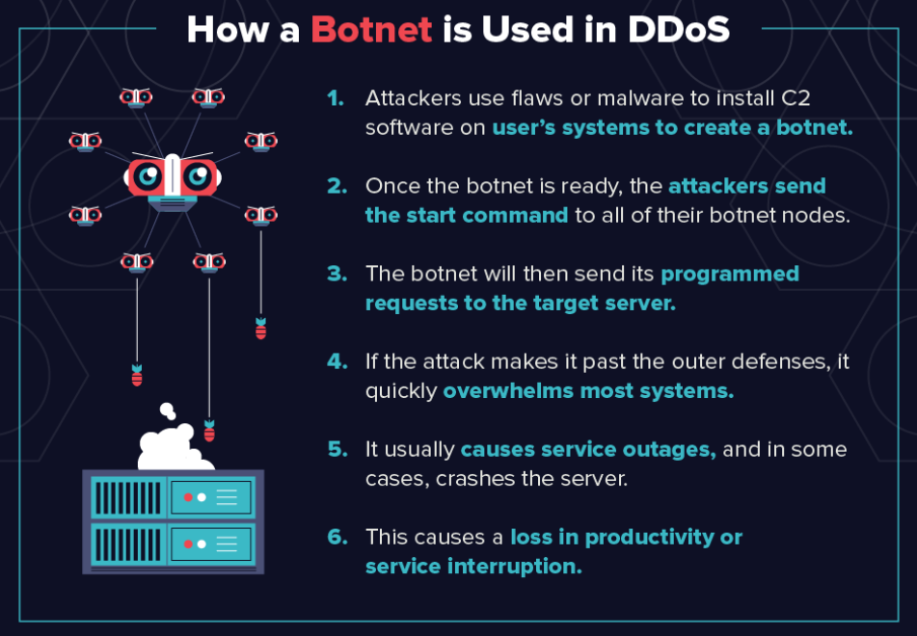

FIG 1. PHASES OF DDOS ATTACK [3]
FIG 2. DESCRIPTION OF BOTNETS [5]
R
FIG 3. ARTICLES ON DDOS ATTACK [2]

Slide 7
LITERATURE REVIEW
S.NO. | RESEARCH PAPER | PUBLICATION & YEAR | FOCUS | LIMITATIONS
1. 2. 3. | Android Malware Detection Techniques in Traditional and Cloud Computing Platforms Attacks and countermeasures on blockchains: A survey from layering perspective. Exploring the attack surface of blockchain: A comprehensive survey. | Vishnoi, A., Mishra, P., Negi, C., & Peddoju, S. K. (2021) Wen, Y., Lu, F., Liu, Y., & Huang, X. (2021) Saad, M., Spaulding, J., Njilla, L., Kamhoua, C., Shetty, S., Nyang, D., & Mohaisen, D. (2020) | Developed a hybrid Android malware detection model combining network traffic characteristics and KNN. The paper surveys attacks on blockchains and countermeasures by, examining security at different layers of the blockchain architecture. survey of the attack surface of blockchain, detailing various vulnerabilities and potential attack vectors. | Not encompass the latest malware detection advancements and emerging threats due to the rapidly evolving nature of Android malware. Not address all potential attacks or countermeasures, especially those emerging in newer blockchain technologies and applications. Not cover all possible future attack scenarios or emerging blockchain applications.
R

Slide 8
LITERATURE REVIEW
S.NO. | RESEARCH PAPER | PUBLICATION & YEAR | FOCUS | LIMITATIONS
4. 5. | Detection of Distributed Denial of Service Attacks in SDN using Machine learning techniques. Mitigating DDoS with PoW and Game Theory. | Sudar, K. M., Beulah, M., Deepalakshmi, P., Nagaraj, P., & Chinnasamy, P. (2021, January) Sung, K. Y., & Hsiao, S. W. (2019, December). | Paper investigates the detection of DDoS attacks in SDN using various machine learning techniques. Paper explores a mitigation strategy for DDoS attacks using Proof of Work (PoW) and game theory concepts. | Not account for all DDoS attack types or the scalability of machine learning models in real-time applications. Not consider the practical implementation challenges or the scalability of the proposed approach in real-world scenarios.
R

Slide 9
RESEARCH GAP
Detection Speed and Computational Overhead: Entropy methods offer fast detection with low overhead but lack accuracy; machine learning improves accuracy but increases processing time.
Real-Time Realization for IoT Devices: IoT and UAVs have limited power for deep learning, complicating real-time DDoS detection due to high computational demands.
Adaptive Threshold and Feature Selection: Adaptive thresholds are needed to handle evolving attack patterns, but they increase computational overhead.
Self-Learning and Adaptation: Future detection frameworks must quickly adapt the changing attack patterns, especially with 5G networks.
Data Quality Issues: Detection accuracy depends on high-quality, up-to-date datasets, but many current datasets are outdated or imbalanced.
Lack of Real-Time Datasets: Real-time datasets are scarce due to ethical concerns, and most available ones are outdated or simulated.
R

Slide 10
PROBLEM STATEMENT
DDoS attacks overwhelm networks, making services unavailable to legitimate users. Traditional networks struggle to mitigate these attacks due to static architectures and limited programmability.
SDN provides a flexible, programmable solution by separating the control and data planes. However, SDN still remains vulnerable to attacks targeting the control plane with excessive flow requests.
Project aims to develop a system that uses flow-based traffic analysis to detect and mitigate DDoS attacks in SDN networks, ensuring robust performance and availability.
R

Slide 11




DDOS NETWORK
Distributed Network of Bots is known as BotNet.
End-users are denied from accessing resources.
Creates & sends Malicious Packets in form of Botnet.
VICTIM
VICTIM
BOTMASTER
VICTIM
R
BOT
FIG.3 DDOS NETWORK [4]

Slide 12
FLOWCHART
START
NORMAL TRAFFIC
INITIALIZE TRAFFIC FLOW
ATTACK TRAFFIC
FEATURE EXTRACTION
GENERATING DATASET
DATA PREPROCESSING
TRAIN MODEL
R
NORMAL TRAFFIC
ML MODEL
ABNORMAL TRAFFIC
END
MITIGATION MODULE

Slide 13
METHODOLOGY
Traffic Feature Extraction: Track specific traffic features to help identify DDoS attacks :
Speed of Source IP: Number of source IPs within a specific time.
Flow Count: How many flows (connections) are detected.
Speed of Flow Entries: How quickly flows are entering the switch.
Ratio of Pair-Flow Entries: The number of interactive IPs compared to the total number of flows, which can reveal abnormal patterns during an attack.
Machine Learning for Detection: Support Vector Machine (SVM) and Decision Tree algorithms are used to distinguish between normal and attack traffic. The system is trained on both types of traffic data to help the ML model predict attacks.
R

Slide 14
METHODOLOGY
Data Collection : Collect data on normal and attack traffic separately, store it in a CSV, and use it to train the ML algorithm.
Detection and Mitigation : After training, the ML model can monitor traffic in real-time. When attack traffic is detected, it blocks the affected port for a set time (120 seconds) to prevent further intrusion. This process repeats if the attack persists.
Environment and Tools : Use Mininet to simulate the network, OpenFlow protocol for communication, Ryu controller to manage the network rules, and tools like Hping3 and Iperf to generate and test traffic.
R

Slide 15
METHODOLOGY
To set up the simulation platform on Ubuntu 20.04.1 LTS for a DDoS attack detection project, follow these steps:
Update and Upgrade Ubuntu and Python:
sudo apt-get update
sudo apt-get upgrade
sudo apt install python2
sudo apt install python3
2. Install OpenFlow Protocol (OpenVSwitch):
sudo apt-get install openvswitch-switch
ovs-vsctl --version
3. Install Ryu Controller:
sudo apt install python3-pip
sudo pip3 install ryu
ryu-manager --version
4. Install Mininet:
sudo apt-get install mininet
mn –version
5. Install Hping3 and Iperf:
sudo apt-get install hping3
sudo apt-get install iperf
6. Install Additional Python Packages for Ryu:
sudo pip3 install numpy
sudo pip3 install sklearn
R

Slide 16
METHODOLOGY
DDoS Attack Detection and Mitigation Simulation
Detect Normal Traffic:
Set APP_TYPE=1 in controller.py.
Set TEST_TYPE=normal and TEST_TIME=300 in topo.py.
Start Ryu and Mininet topology to generate normal traffic.
Detect and Mitigate Attack Traffic:
Set TEST_TYPE=attack and TEST_TIME=300 in topo.py.
Start Ryu and Mininet as before.
Observe as the controller detects and blocks the attack,
monitoring ports every 120 seconds for ongoing attacks.
Accuracy and Detection Rate Calculation
Calculate Accuracy:
Copy results.CSV into the analysis folder.
Run the accuracy script:
~ python accuracy_score.py
2. Calculate Detection Rate:
Run the detection rate script:
~ python detection_rate.py
3. Generate Graphs:
Run the graph generation script:
~ python graph.py
R

Slide 17
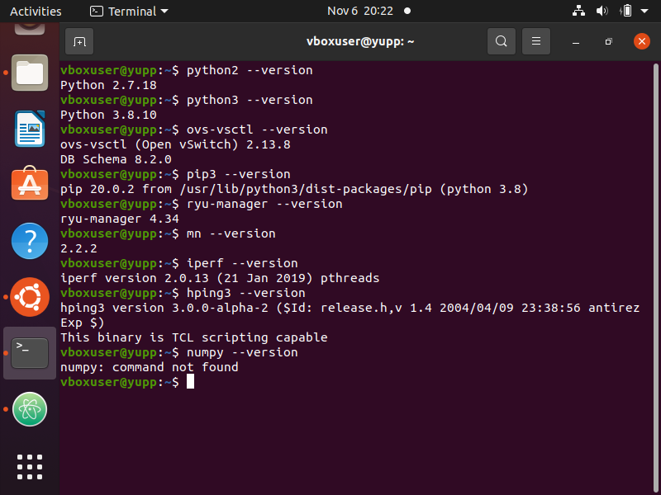
METHODOLOGY
Following are the commands to check whether the libraries are properly installed in ubuntu or not :
R
FIG.5 COMMANDS FOR LINUX LIBRARIES

Slide 18
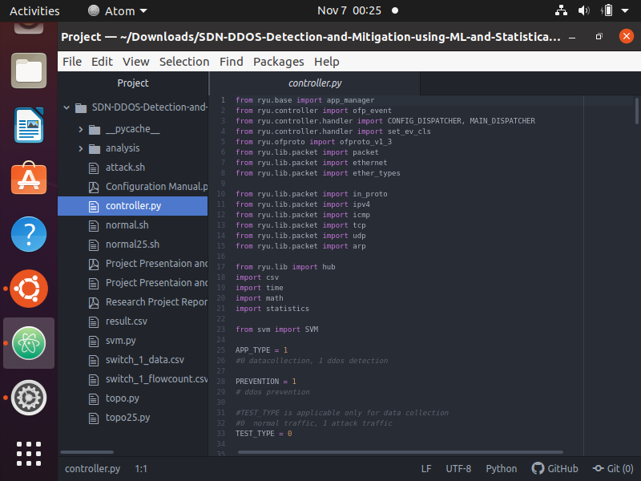
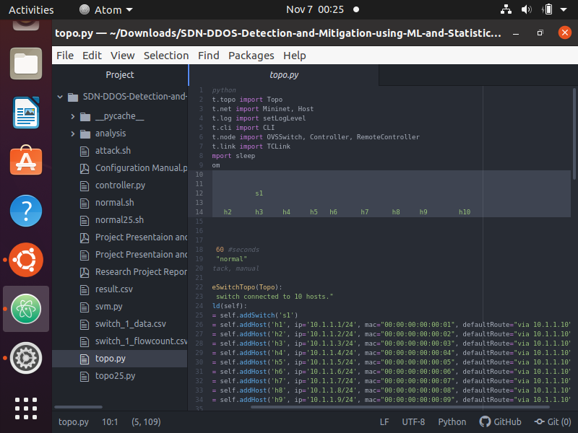
METHODOLOGY
R
FIG.6 CONTROLLER.PY
FIG.7 TOPO.PY

Slide 19
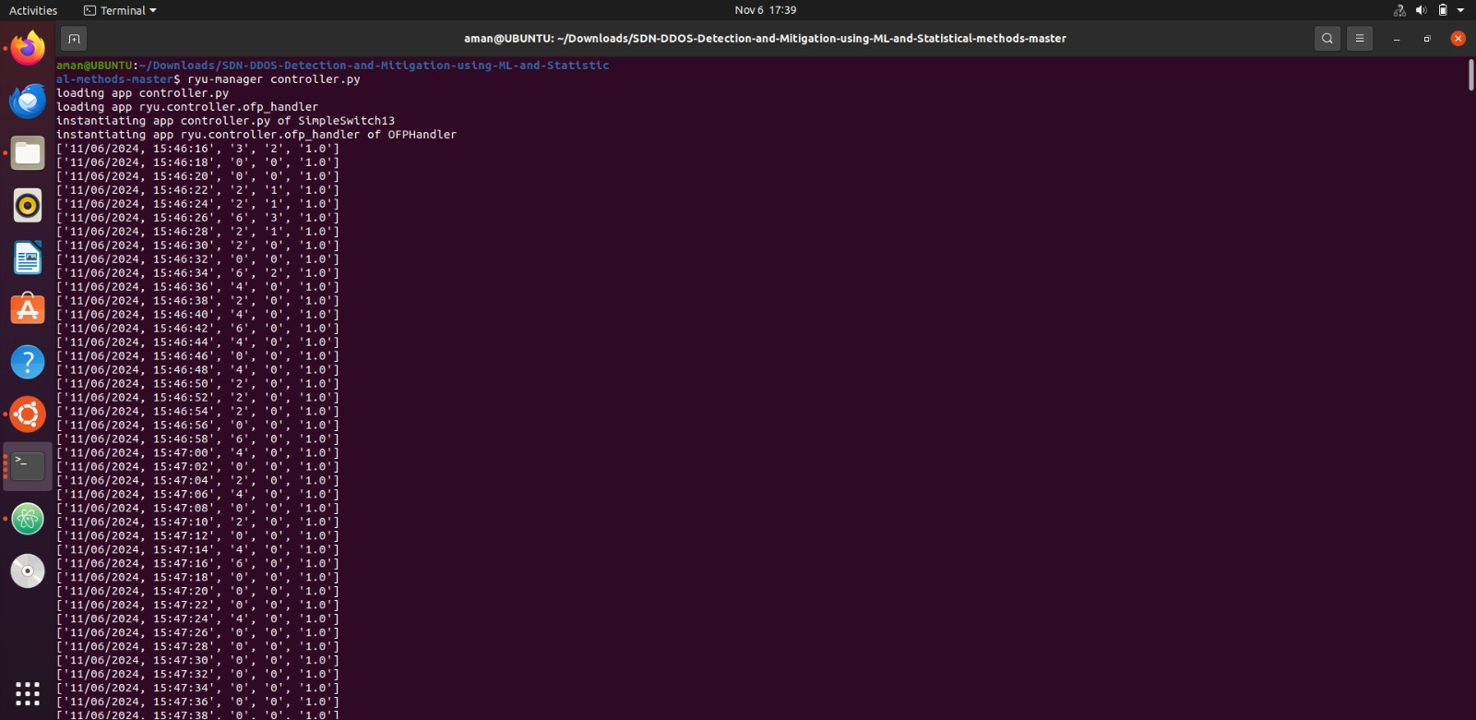
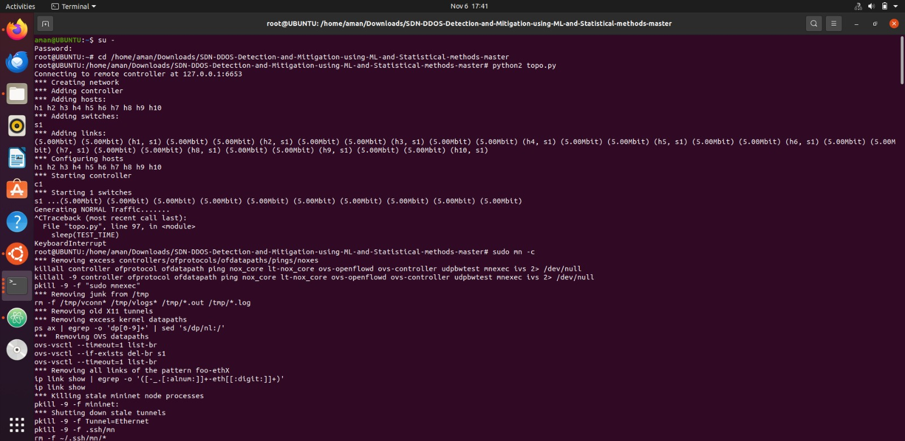
METHODOLOGY
R
FIG.8 RUNNING RYU CONTROLLER
FIG.9 RUNNING MININET

Slide 20
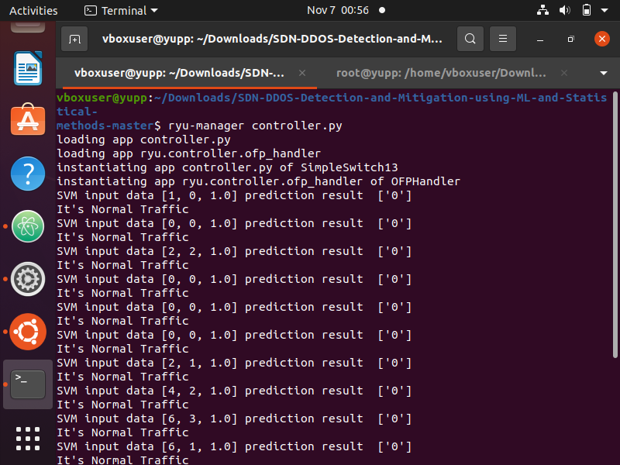
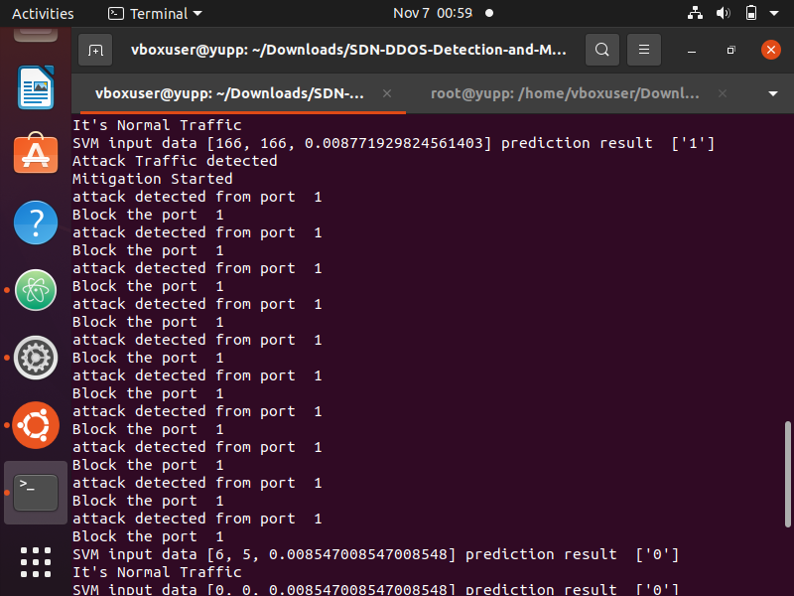
RESULT
R
FIG.10 NORMAL DATA TRAFFIC DETECTION
FIG.11 ABNORMAL DATA DETECTED & MITIGATED

Slide 21
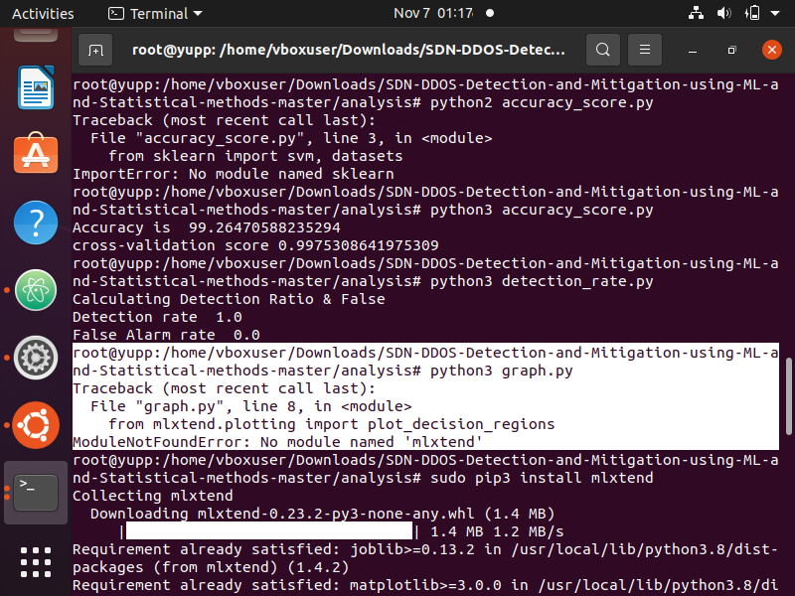
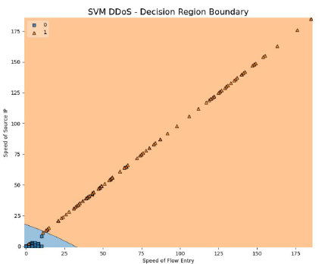
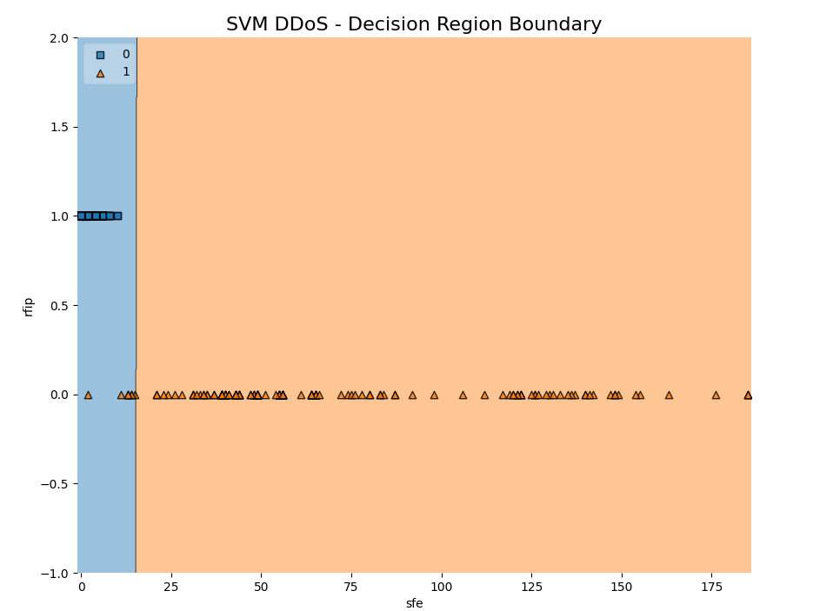
RESULT
ACCURACY
DETECTION RATE
R
FIG.12 SVM GRAPH SOS VS SFE
FIG.13 SVM GRAPH RFIP VS SFE

Slide 22
CONCLUSION
As a conclusion ,
Software defined network provides us the capabilities to design and perform operations in
the network by programming which is not case with traditional networks.
Using SDN to detect and mitigate DDOS attacks in cloud environment was the main goal of this work.
The implemented method is a combination of statistical features like source of IP, speed of flow entries,
flowcount and ratio of flow-pair and SVM machine learning algorithm to detect and predict DDOS
attacks in the network.
Experimented results shows the presented method can provide accuracy of 99.26% and malicious traffic detection rate of 100% with zero false predictions of the traffic.
So as a conclusion the DDOS attack is detected in the streaming packets and is mitigated by blocking the ip address.
R

Slide 23
REFERENCES
[1] Kazeem B. Adedeji , M. Abu-Mahfouz and Anish M. Kurien (2023).DDoS Attack and Detection Methods in
Internet-Enabled Networks: Concept, Research Perspectives, and Challenges.
https://doi.org/10.3390/jsan12040051 .
[2] J.Shroff, R.Walambe, S.Singh, K.Kotecha (2022). Enhanced security against volumetric DDoS attacks using
adversarial machine learning.
https://onlinelibrary.wiley.com/doi/epdf/10.1155/2022/5757164
[3] Shafiq, M.; Yu, X.; Bashir, A.K.; Chaudhry, H.N.; Wang, D (2018) . A machine learning approach for feature
selection traffic classification using security analysis. J. Supercomput.
[4] Evans, D. (2011, April). The Internet of Things: How the Next Evolution of the Internet Is Changing Everything?
https://www.cisco.com/c/dam/en_us/about/ac79/docs/innov/IoT_IBSG_0411FINAL.pdf
[5] C. Li et al. (2018), “Detection and defense of DDoS attack–based on deep learning in openflow-based.
https://doi.org/10.1002/dac.3497
R

Slide 24
REFERENCES
[6] A. Sahi, D. Lai, Y. Li and M. Diykh, "An efficient DDoS TCP flood attack detection and prevention system in a
cloud environment", IEEE Access, vol. 5.
https://ieeexplore.ieee.org/document/7893798
[7] Barbhuiya, S.; Kilpatrick, P.S.;(2016) . Nikolopoulos, D. Linear regression-based DDoS attack detection.
https://doi.org/10.1145/3457682.3457769
[8] Iyengar, N.C.S.N.; Ganapathy, G.(2015). Chaotic theory based defensive mechanism against distributed denial of
service attack in cloud computing environment.
http://dx.doi.org/10.14257/ijsia.2015.9.9.18
[9] Roopak, M.; Tian, G.Y.; Chambers, J (2018). Multi-objective-based feature selection for DDoS attack detection in
IoT networks.
https://doi.org/10.1049/iet-net.2018.5206
[10] Saeed, A.A.; Jameel, N.G.M (2021). Intelligent feature selection using particle swarm optimization algorithm with
a decision tree for DDoS attack detection.
https://doi.org/10.26555/ijain.v7i1.553
R

Slide 25




THANK YOU !!

